Slide 1
Virentis Practice Overview
March 2025

Slide 2
Virentis Overview
Virentis Advisors is a boutique investment banking firm serving clients in the renewable energy industry
Niche focus on bioenergy industry, specifically biogas and renewable natural gas or “RNG”
Experienced team with over $7 billion of project experience since 2008 (over $700 million as Virentis)
Biogas, biomass, wind, solar, hydro, geothermal heating and cooling, composting, advanced fertilizer
Principals all former leaders at large organizations with renewable energy focus:
Mike Land – Baker Tilly renewable energy practice
Max Vernier – Live Oak Bank bioenergy lending group
Chris Bourassa – Union Bank tax equity (prior experience at KPMG)

Slide 3
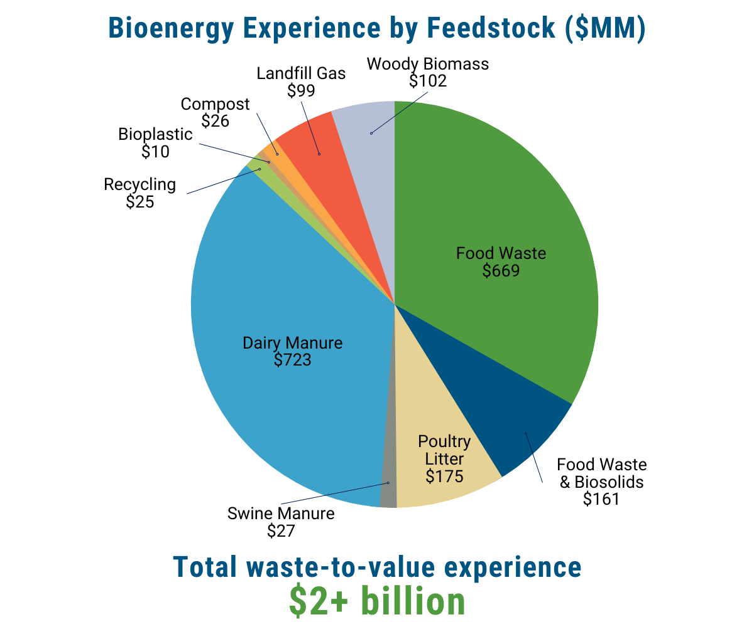
Virentis Overview
Client Types
Wide range of clients across renewable energy and sustainable infrastructure including project developers, utilities, municipalities, oil & gas producers, food & beverage, and energy intensive manufacturers
Project Roles
Tax Credit Consulting and Monetization Support
Placement of Debt and Equity
M&A Support

Slide 4
Bioenergy Tax Credits – A New Asset Class
Impact of Inflation Reduction Act of 2022 (IRA 22)
Bioenergy projects have the unique ability to de-carbonize multiple sectors of the economy with the energy they produce (power, transportation, manufacturing, waste management, commercial and industrial purposes).
There is now broad application of significant federal tax incentives to projects utilizing organic matter to produce energy; ITCs/PTCs now apply to projects producing biofuels used for transportation or heating purposes (previously only applied to projects which generated electricity).
Bioenergy projects can now earn larger ITCs/PTCs (up to 50% ITC), as well as new 45Z PTC for clean fuels production.
Project Owners: Impact of ITC/45Z provisions can mean 25-40% net reduction of projects’ capital needs and increase of 10-35% revenue generation, which enables a sector experiencing dramatic growth to become even stronger economically.
Tax Credit Buyers/Investors: The bioenergy industry has the ability to reduce more carbon emissions, provide direct Scope 1, 2 and 3 benefits and satisfy more ESG mandates per dollar of invested capital than other renewable energy asset classes due to its low “carbon intensity.”
Many of Virentis’ clients have demonstrated pipelines of quality projects, enabling tax investors to pursue long-term arrangements that can apply across multiple projects and tax years, reducing the amount of work per opportunity and locking in volume with some degree of diversification.

Slide 5
Tax Credit Transfer Experience To-Date
21 ITCs sold (all bioenergy)
Total ITC Value: $203 million, ranging from $1.5 - $46 million
2 FMV T-Flip transactions, each $29 million ITCs
Preferred equity deals, 30% step up, full tax credit insurance wrap
Adders: 12 Domestic Content, 6 Energy Community (2 brownfields)
Pricing Average: Approximately $0.92 per $1 of ITC (net of buyer advisor fee)

Slide 6
Transfer Experience To-Date…
Tax Credit Optimization
Determination of “functional interdependence” and “integral” – base ITC eligibility
Domestic Content framework determination and subsequent documentation support
Energy Community, including brownfield safe harbor documentation support
PW&A – support interaction with outside third-party providing certification report
45Z sizing and documentation support
Tax Credit Monetization
FMV Step-up transaction support: deal structuring, negotiation and financial modeling
Buyer outreach, negotiation, diligence and closing support
Coordination of third-party interaction and diligence
Tax credit insurance provider
Cost segregation study, domestic content and PW/A certification report providers
Independent engineers and carbon emission verifiers

Slide 7
MICHAEL J. LAND
Managing Partner
Mike has more than 30 years of experience providing financial advisory and private investment banking services to clients, the last 14 years focused exclusively on the energy and infrastructure industry. This includes development support, deal structuring, tax credit monetization, grant procurement, funding placement of both equity and debt, and general corporate finance consulting.
Mike assists clients in a wide range of energy sectors including utilities, manufacturers, universities, municipalities, and developers. Scope of assistance typically includes a lead role in the project/transaction, including:
Feasibility, due diligence, and project development support
­Deal structuring and valuation support
­Identification and sourcing of capital needs
­Transaction/funding negotiation and closing support
Mike was the original founder of a national CPA firm’s Energy and Infrastructure (EIG) practice in late 2007. Since that time, the EIG team has supported over 200 projects that are either built or under construction, ranging from $5 million to $400 million and totaling more than $4.21 billion in construction value. These projects include energy from waste, biomass, wind, solar, hydro, and geothermal heating and cooling.
Industry Involvement
Past Board Member of the American Biogas Council
Financial Industry Regulatory Authority (FINRA) Series 7, 63 and 79 securities licenses
Frequent speaker at energy and infrastructure
Contact
Madison, WI
+ 1 (608) 770.6545
mikeland@virentisadvisors.com
Education
Master of Business Administration
University of Wisconsin – Madison
Bachelor of Science
Industrial Engineering
University of Wisconsin – Madison

Slide 8
MAX VERNIER
Managing Partner
Max is an investor, developer, and capital advisor in the sustainable infrastructure and renewable energy sectors, bringing 12 years of experience to the firm.
He previously spent nine years with Live Oak Bank (NYSE: LOB), most recently as an SVP, where he started a lending vertical dedicated to projects and developers across the bio-economy, with a specialty in project finance and government-guaranteed loans (SBA, USDA, DOE). He was responsible for leading a team of lenders and analysts originating loan opportunities, structuring deals, supervising construction completion and startup commissioning, and syndication efforts in the capital markets.
Prior to starting the Bioenergy team, he held various roles within the bank ranging from portfolio management and servicing to credit underwriting and loan origination.
Within the broader Energy & Infrastructure group, Max had exposure to a variety of debt products and project types including utility-scale and community solar, battery storage, waste-to-energy, anaerobic digestion, composting, landfill gas, municipal wastewater treatment, agricultural waste management, organic fertilizer, bioplastics, biobased product manufacturing, and other advanced recycling technologies.
Max is a partner and CFO of a bioenergy project development company that focuses on public-private partnerships with municipalities to convert landfill gas (carbon dioxide and methane) into energy, fuel, and useful products.
Industry Involvement
­Past Board Member of the American Biogas Council (2020-2024)
Current Board Member of the Alternative Fuels & Chemicals Coalition (2020-Present)
Contact
Wilmington, NC
+ 1 (734) 751.8544
maxvernier@virentisadvisors.com
Education
Bachelor of Arts in Economics
Washington & Lee University

Slide 9
CHRIS BOURASSA
Partner
Chris brings 17 years of corporate tax advisory and tax equity financing experience to the firm, providing project finance advisory and private investment banking services to renewable energy clients focused on the waste-to-value space. Typical scope includes:
­Tax incentives eligibility and optimization
Financial modeling
­Deal structuring and valuation
­Identification and sourcing of capital needs
Prior to joining Virentis, Chris spent a year with Baker Tilly Capital’s Energy and Infrastructure group and five years with the Global Corporate and Investment Banking business at MUFG Union Bank. Key responsibilities included:
Built tax equity and tax lease structure deal pricing models to analyze investment returns and risk profiles in support of a >$4B portfolio consisting of >40 tax equity financings for wind and solar projects as well as >100 tax advantaged lease transactions.
Monitored projects for contractual compliance and alignment to earnings and budgeting projections.
Developed and communicated tax credit optimization and monetization strategies to US LOB’s.
Lead development and implementation of a bank-wide US tax capacity policy framework
Prior to 2016, Chris was a Senior Manager in KPMG’s national Tax Ignition practice in addition to holding various managerial roles in corporate tax, specializing in tax reporting (SOX 404) and compliance related to passive equity partnerships, and tax lease structures. Chris lead >20 projects for banking and Fortune 50 clients, providing tax strategy and process advisory to optimize tax cash efficiencies.
Contact
Contact
Los Angeles, CA
+ 1 (312) 415.5668
chrisbourassa@virentisadvisors.com
Education
Master of Business Administration
University of North Carolina at Chapel Hill
Master of Science, Taxation
Golden Gate University
Bachelor of Science
Chapman University

